Slide 1
Welcome Back To School
We are so excited to start the new year!

Slide 2
We are looking forward to a great year!

Slide 3
When you arrive at school…
Get Your Temp Checked
NO Temp
Got A Temp
NO TEMP_GREEN STICKER
SANTITIZE
GRAB A BREAKFAST
GO TO BATHROOM AND CLASSROOM
Red sticker
Santitize
Grab a breakfast
Go to the "sick room"

Slide 4
Dress code
Uniforms will be checked in homeroom each morning.
Make sure you are following the dress code provided for you in your handbook. Let’s look at it now…
Failure to follow dress code will result in an infraction.
This Photo by Unknown Author is licensed under CC BY-SA

Slide 5
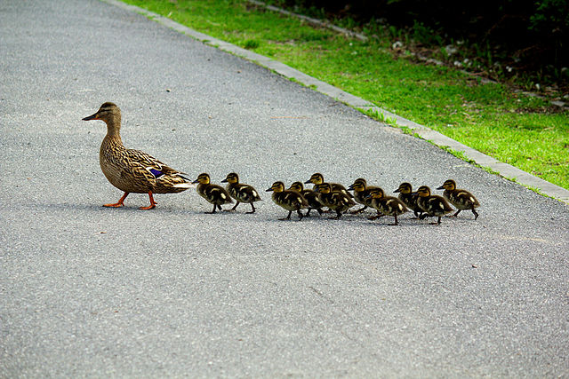
Transitions
Remember:
Mask Up
Other classes are having class. Be respectful and walk carefully and quietly.
Pay attention and keep your hands and feet to yourself. (Make sure you are social distancing) Other teachers may see you and give you a pride pass. You pass many people during transitions, and they will be watching to see if you are doing what you should be doing.

Slide 6
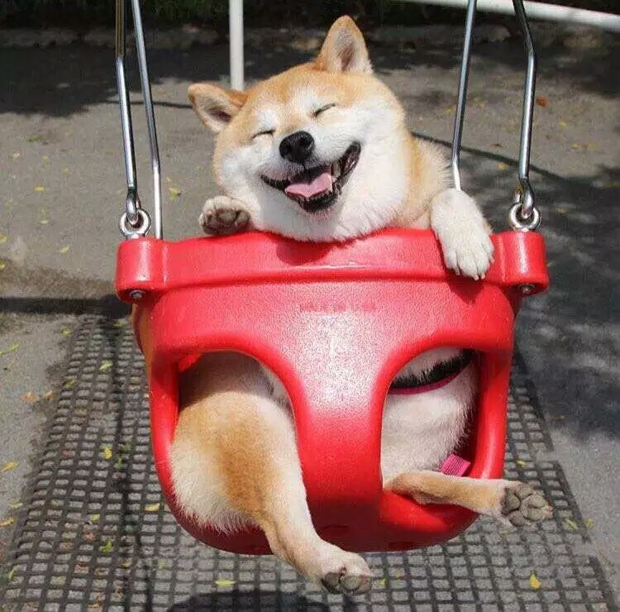
When it's time for Recess…
Walk down the hallway
Walk to your class Designated Area
Talk with your friends and relax a little while!

Slide 7
Why should you follow the rules?
They Keep everyone safe at school.
Rules are enforced to help you learn.
You will earn pride passes!

Slide 8
Pride Pass Incentives
10 passes- pen for a day/sit in a special/vacant seat for the day
5 passes-shoes off or eat a snack in class
15 passes- jeans
20 passes- say announcements, or fidget spinner for a day
30 passes- 30 min. free computer time, or Mrs. Melyssa’s Store of Prizes

Slide 9
30 minutes free computer time
Free smoothie
20 pride passes
Ms. Melyssa’s Store of Prizes
Say pledge and morning Announcements
Monthly School Wide Drawing

Slide 10
Weekly Prize pack winners
Those students who have not received a warning for the week will be eligible for a drawing on Monday mornings in homeroom class to win 5 pride passes.

Slide 11
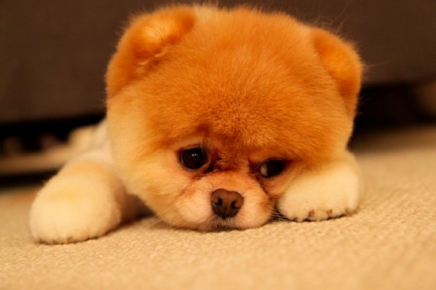
Infractions

Slide 12
Infractions are given for breaking rules
Infraction order
4 warnings in a day, 5 warnings in a week, 6 warnings in a month, or 12 warnings in a semester will result in an infraction
1st infraction – Behavior journal
2nd infraction- call home/behavior journal
3rd infraction- office referral

Slide 13
Do infractions matter?
Students who have no infractions at the end of the month will receive a reward extra recess, popsicle, etc.).
Students who receive no infractions August-December will get a Prize Pack of Goodies!
There will be a second Prize Pack for those students who receive no infractions from January-May.
This Photo by Unknown Author is licensed under CC BY

Slide 14
Let’s Have a great school year
Remember to be the very best you that you can be!
This Photo by Unknown Author is licensed under CC BY-NC-ND

